Slide 1
Non-Photorealistic Rendering
Samyukta Jadhwani
Akshay Joshi
Ritambhara Singh
Jacob Steele

Slide 2
The Styles!
Cartoon
Painterly
Pencil Sketch
Pointillism
Vampirize
Etc…

Slide 3
The Results
The Website
http://128.143.63.69/filter.html
The Tablet
Toshiba Tablet with Android SDK

Slide 4
The Website
Allows user to select a local file and applies 1 of several filters to the image
Then displays the image allowing the user to save it to local storage

Slide 5
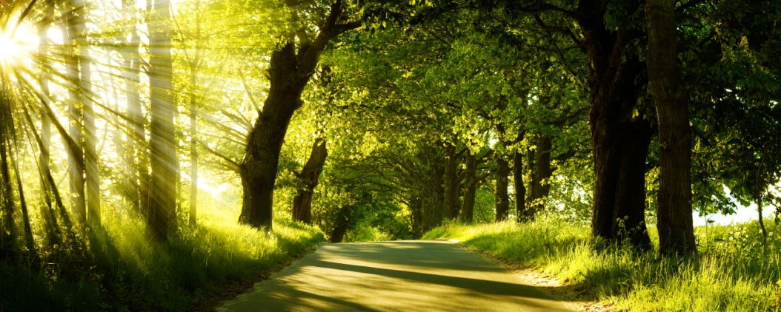
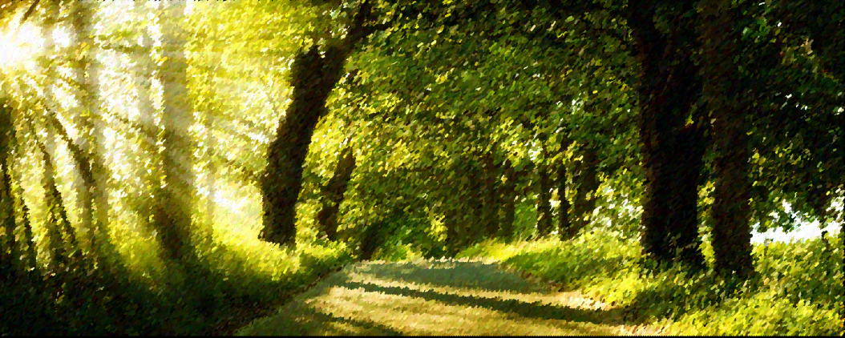
Results

Slide 6
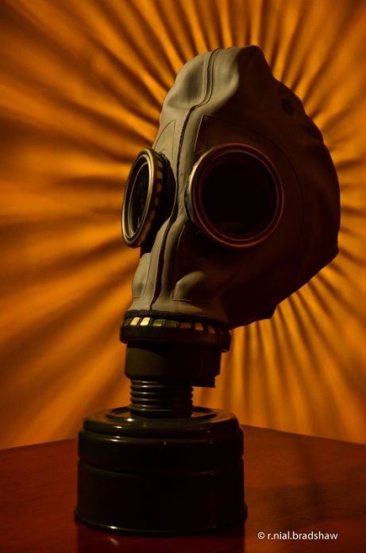
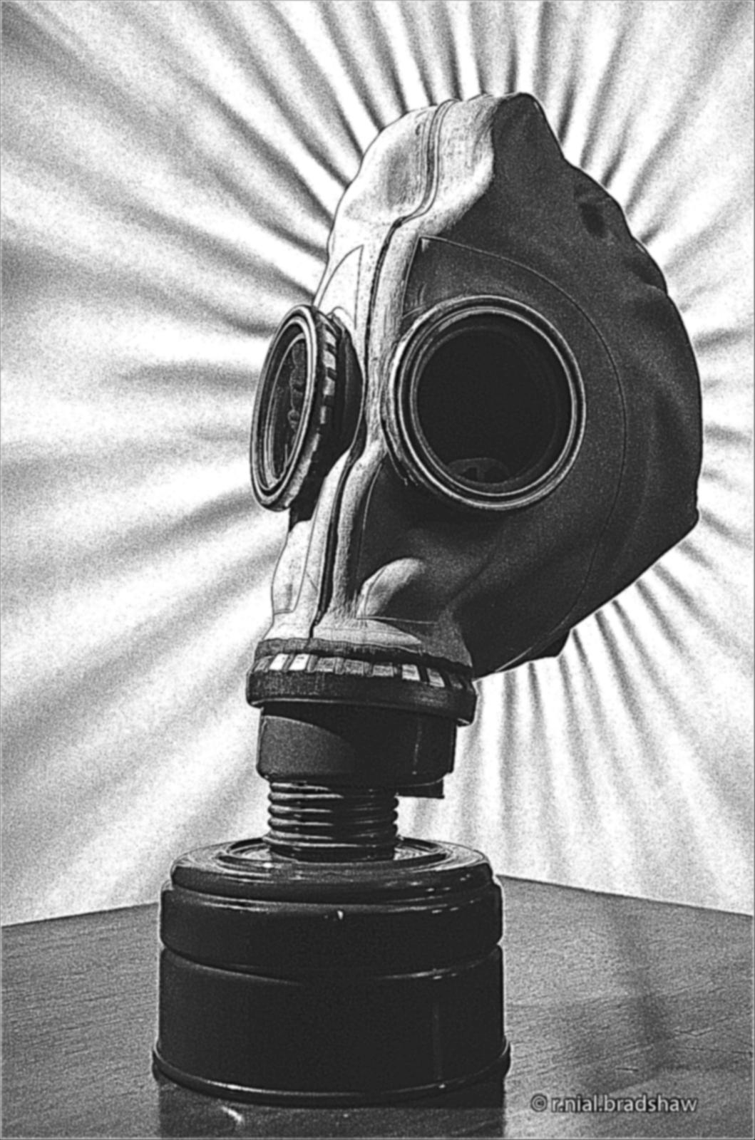
Results

Slide 7
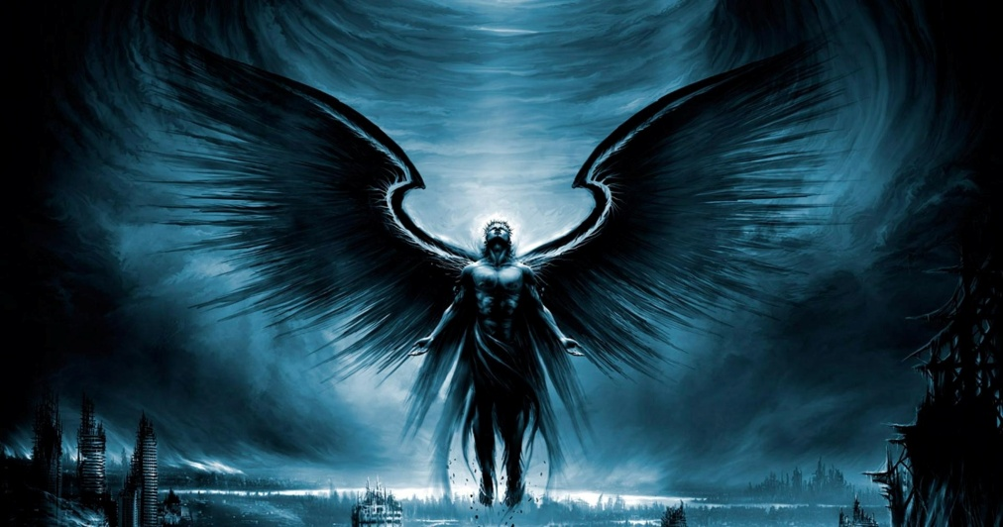
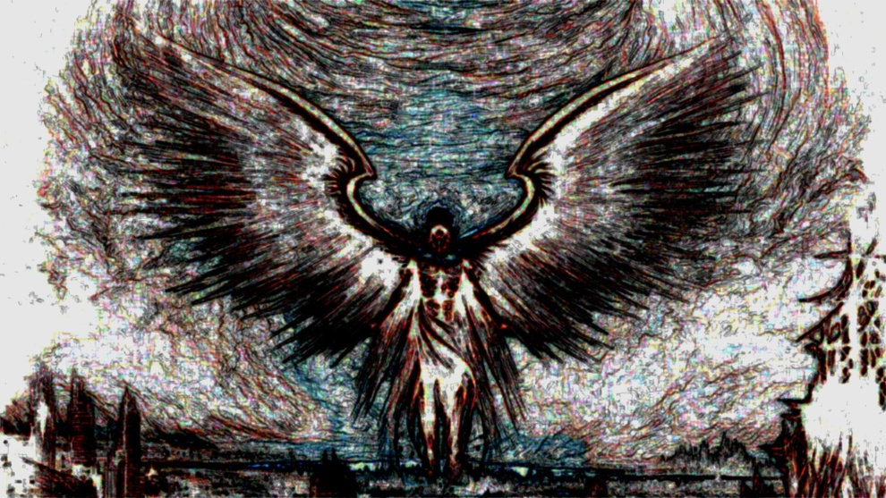
Results

Slide 8
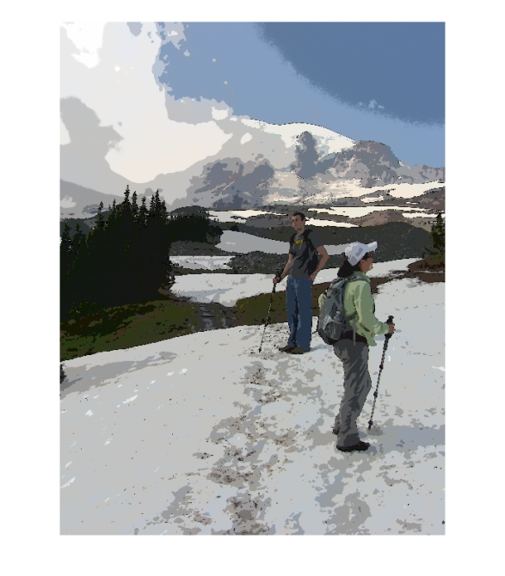
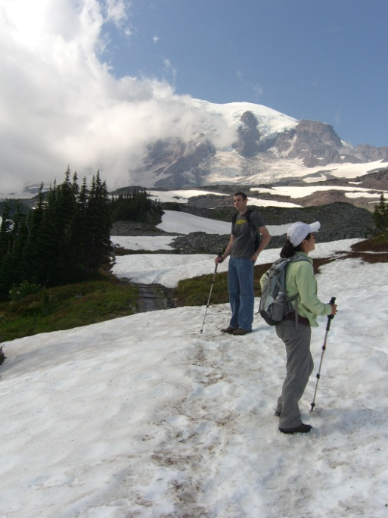
Results

Slide 9
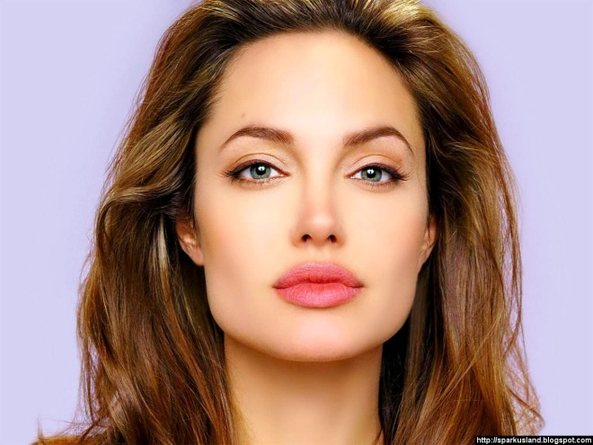
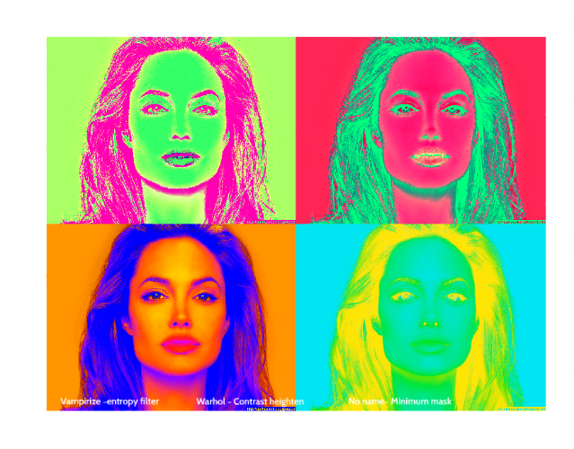
Results

Slide 10
The Tablet Results
Tablet App Allows user to apply a filter to a store photo or take a photo with the filter applied to it
Supports Pen and Ink and Painterly
Wanted Video, but applications take to long and Android SDK wasn’t complying

Slide 11
Tablet Demo

Slide 12
Challenges
Code Runtime
Matlab Doesn’t port well to Android SDK
Android SDK
Doesn’t fully support java.awt/java.swing
Doesn’t work with Matlab-converted to C/C++

Slide 13
Questions

